Slide 1

A Seminar
On
PID Controller
Submitted by
Taniya Sirohi
(2316995)
Supervised by
Rahul Katiyar
(Assistant Professor)
SCHOOL OF AUTOMATION
BANASTHALI VIDYAPITH RAJASTHAN
October 2024

Slide 2

Content
Introduction to PID Controller
Problems solved by PID Controller
Components of PID Controller
Mathematical Representation
Tuning Methods
Applications
Industrial Automation
Energy Systems
Advantages
Disadvantages
Conclusion
References

Slide 3
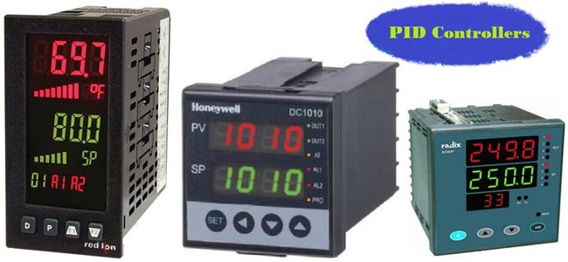
Introduction to PID Controller
PID refers to the Proportional, Integral, and Derivative.
It is a feedback control system which is used to maintain
a desired output by adjusting the inputs.
It is used to enhance system stability and performance by
adjusting the control actions.
falibert.blosport.com, accessed on september16,2024

Slide 4
Problems solved by PID controller
Steady-State Error
Slow Response Time
Disturbance and load change
Variable System Dynamics

Slide 5
Components of PID controller
PID Controller
Proportional Control
Integral Control
Derivative Control

Slide 6
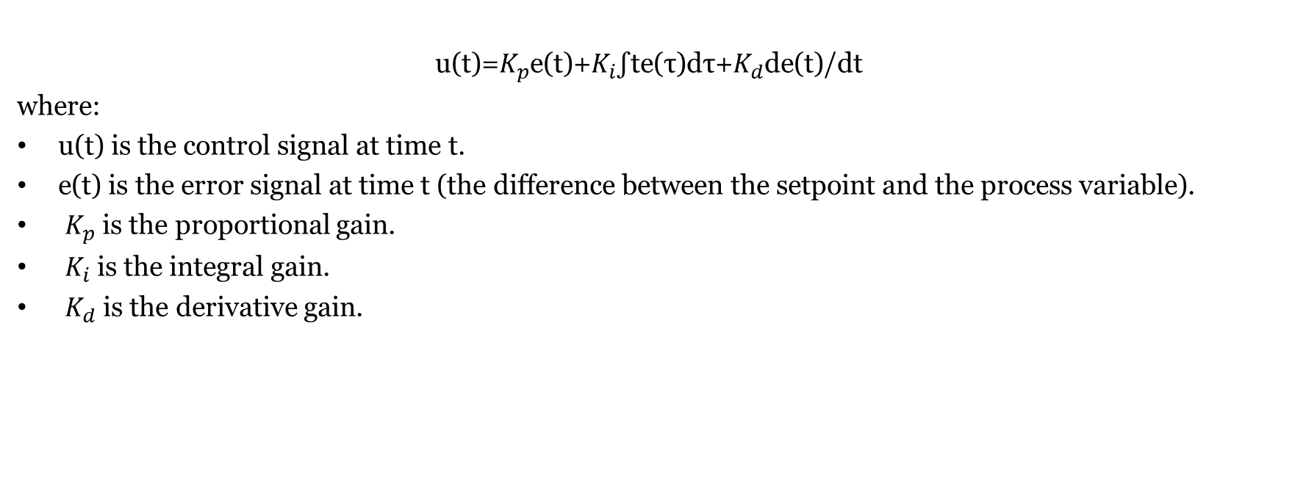
Mathematical Representation
u(t)=$K_{p}$​e(t)+$K_{i}$​∫t​e(τ)dτ+$K_{d}$d​e(t)/dt
where:
u(t) is the control signal at time t.
e(t) is the error signal at time t (the difference between the setpoint and the process variable).
​ $K_{p}$is the proportional gain.
​ $K_{i}$ is the integral gain.
​ $K_{d}$is the derivative gain.

Slide 7
Tuning Methods
Ziegler-Nichlos Method
Cohen-Coon Method
Trial and Error Method

Slide 8
Applications of PID controller
Industrial Automation
Energy Systems
Water Treatment

Slide 9
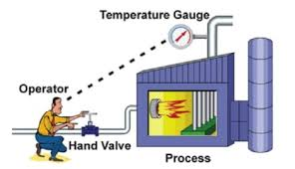
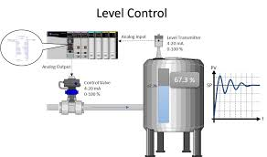
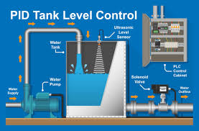
Industrial Automation
Temperature control
Pressure control
Humidity control
Level control
Flow control
Speed and Position control

Slide 10
Energy Systems
Renewable Energy Systems
Battery Management System
Hydropower Plants
HVAC Systems

Slide 11
Advantages of PID controller
Improved System Stability
Error Elimination
Dynamic Response
Reduced Manual Work
Customizable Performance

Slide 12
Disadvantages of PID controller
Complex Tuning
Sensitive to Noise
Increased Load for Complex Systems

Slide 13
Conclusion
Widely Used
Error Minimization
Improved Stability
Tuning required
Versatile Application

Slide 14
References
Jens Graf, 2016, PID Controls Fundamentals
Rames C. Panda, 2012, Introduction to PID Controllers

